Slide 1
For Live Session Unit 10
Javier Saldana

Slide 2
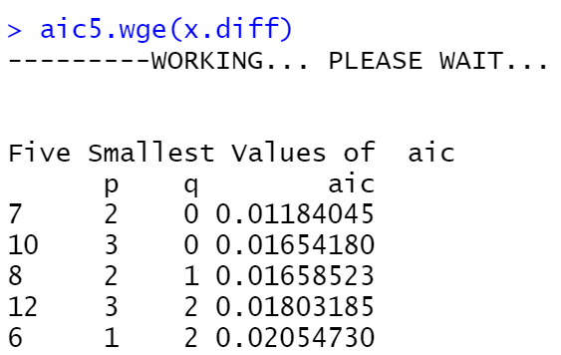
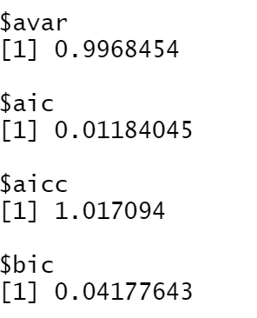
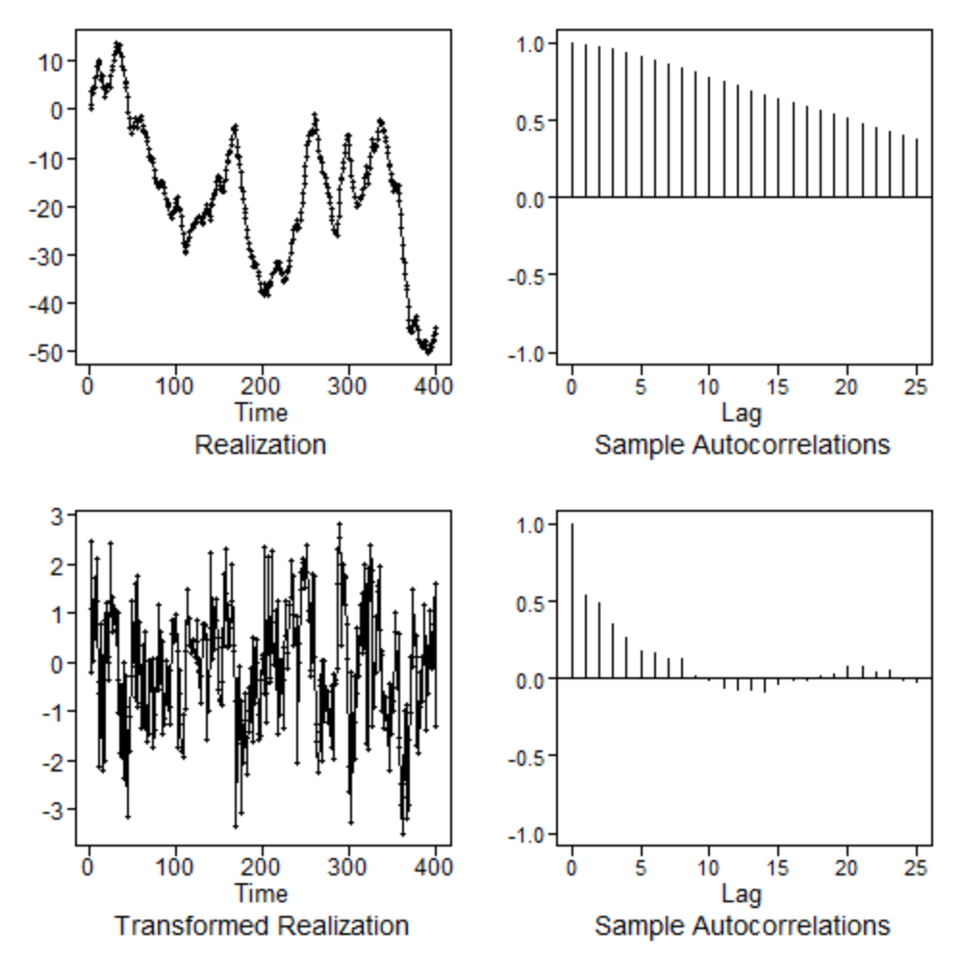
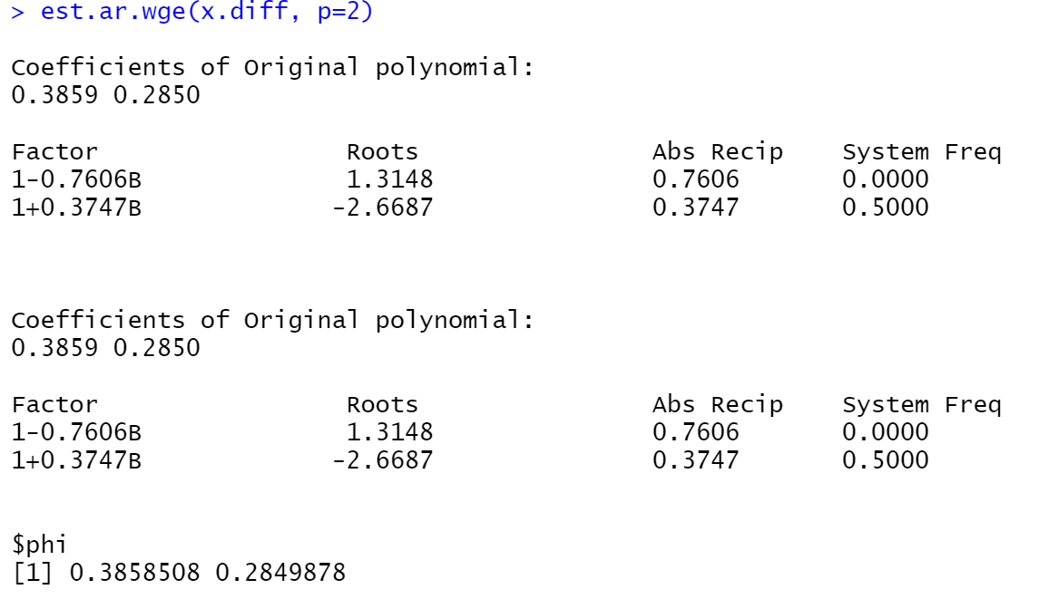
ARIMA

Slide 3
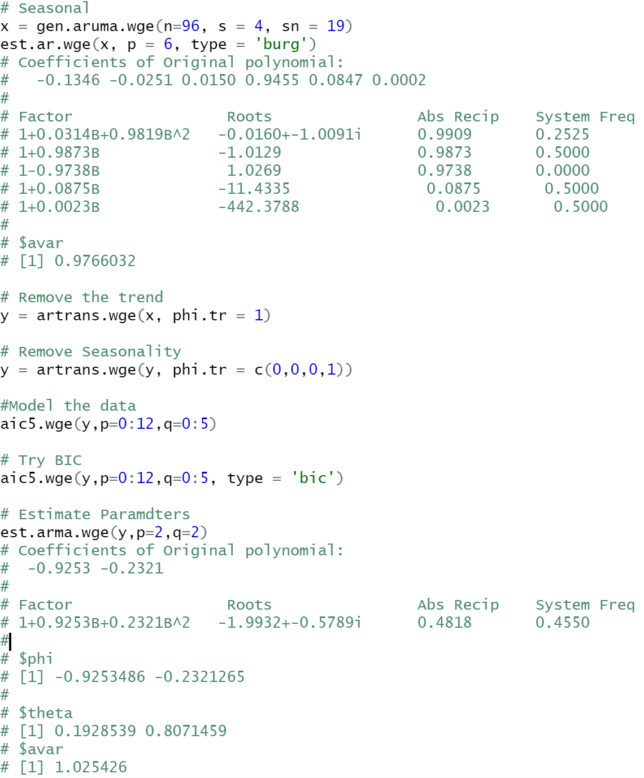
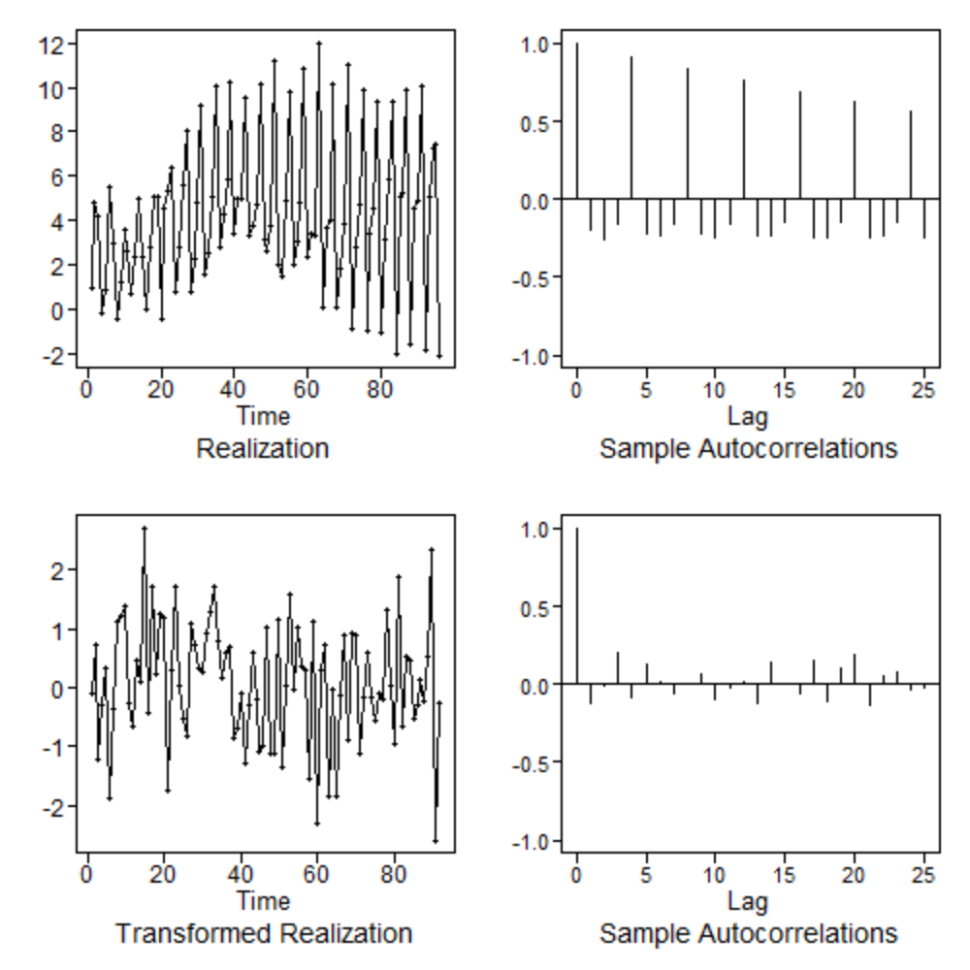
Seasonal

Slide 4
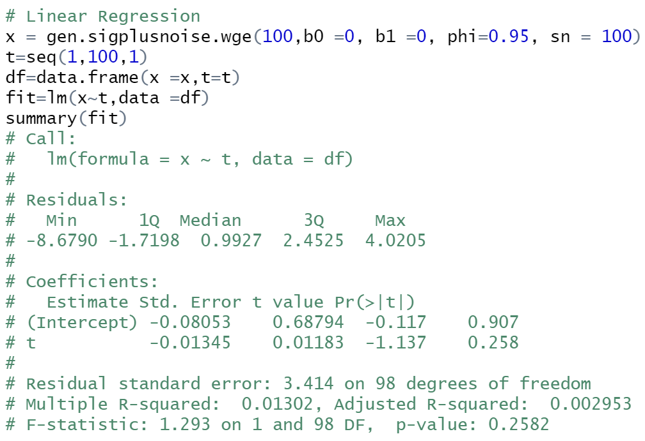
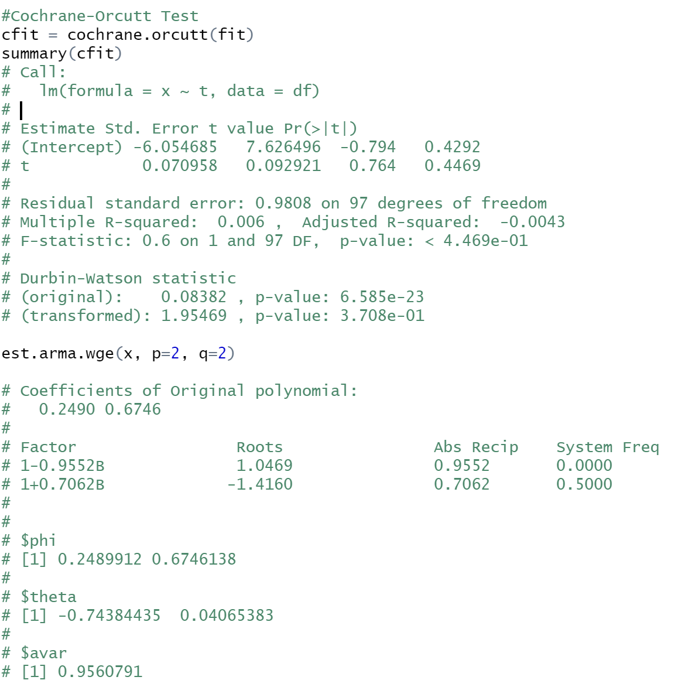
Signal Plus Noise w/ Cochrane-Orcutt

Slide 5
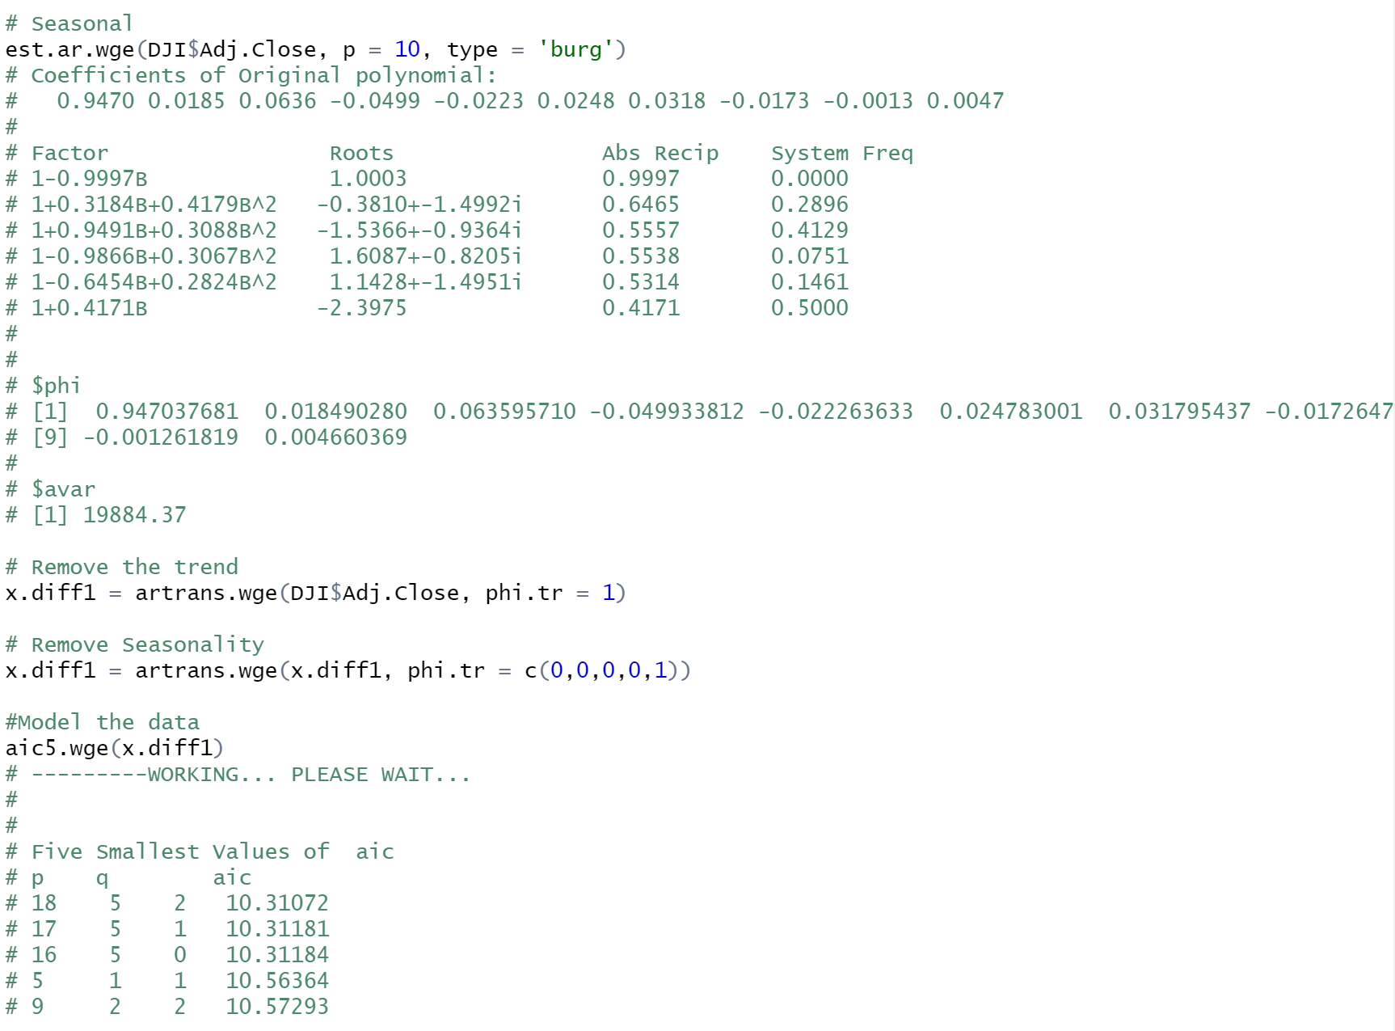
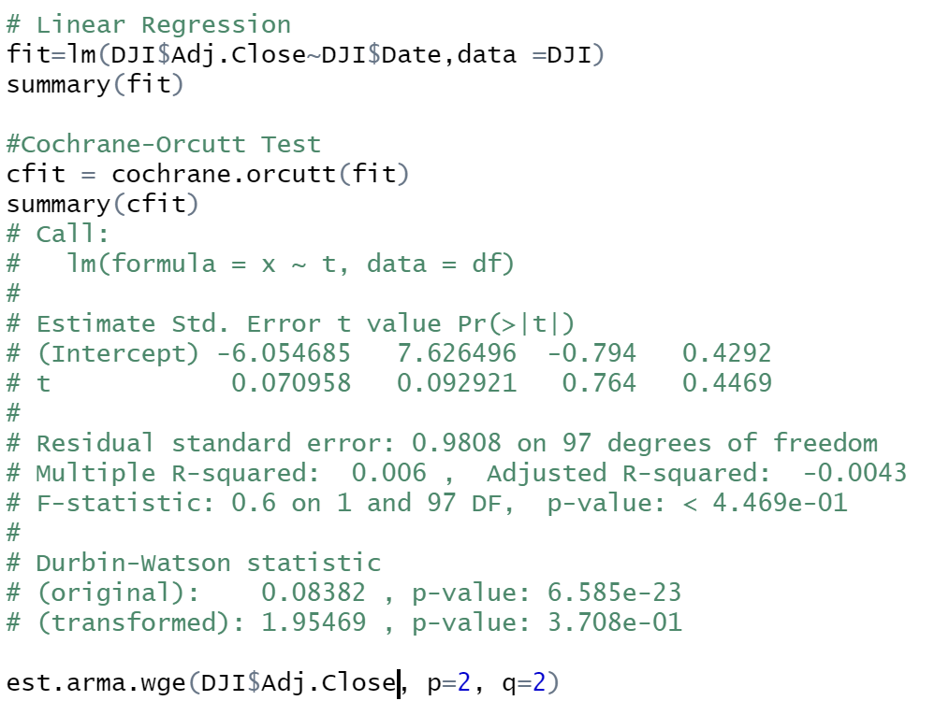
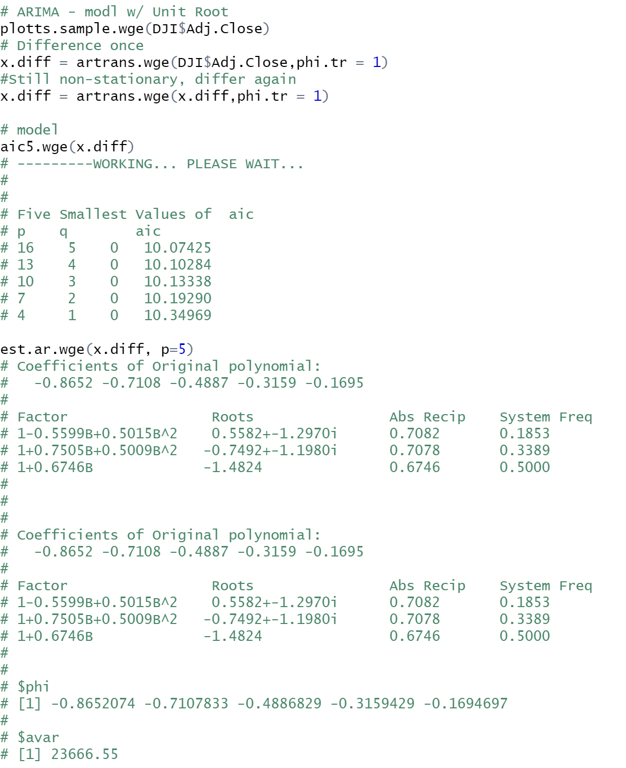
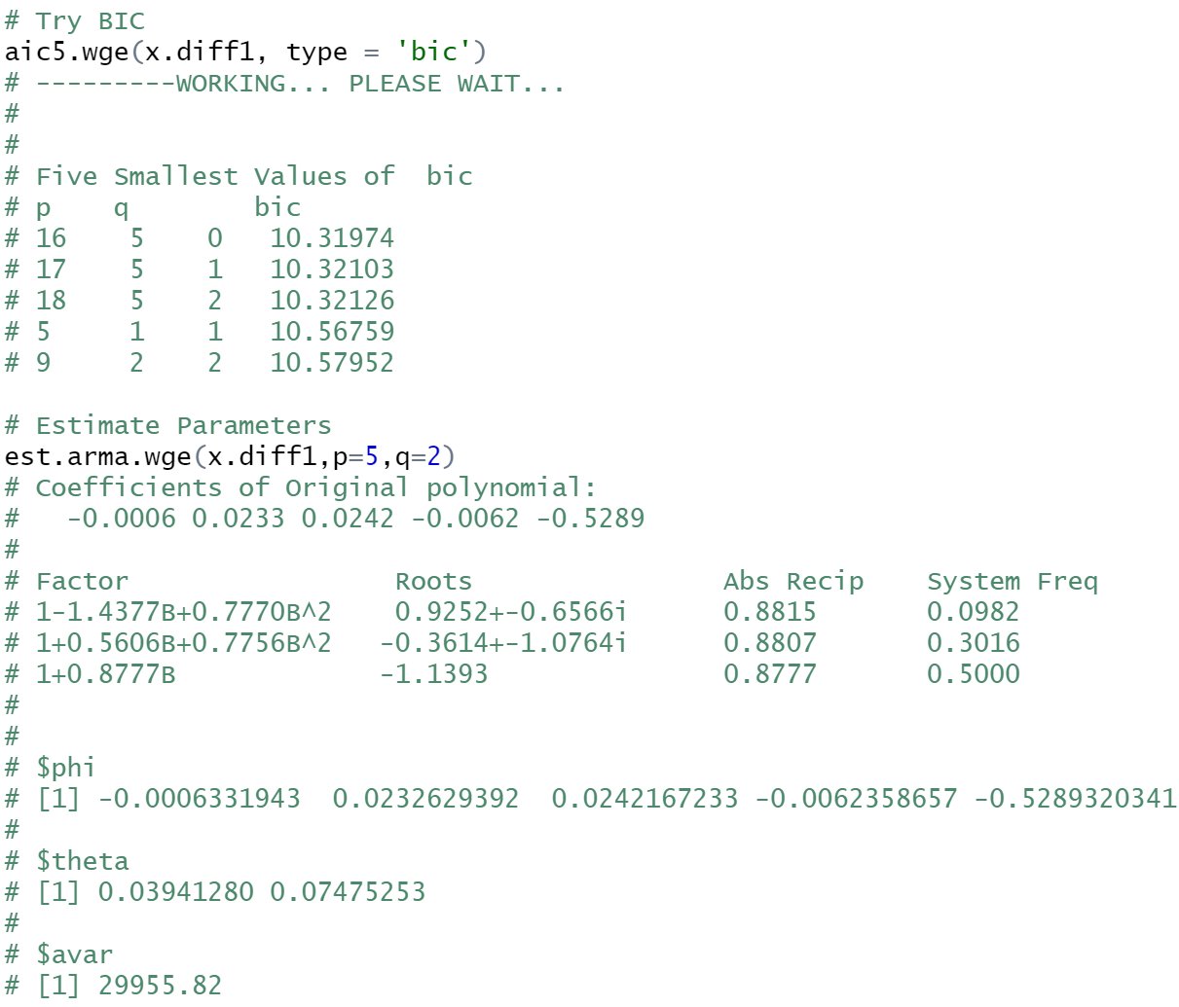
All combined w/ my Data Set

Slide 6
Key Takeaways & Thoughts
Key takeaways is that as the phi gets closer to the unit circle, many of the tools lose effectiveness. While there are many tools available, we want to focus on the Cochrane-Orcutt method in order to test the hypothesis for trends in the data set. The most important piece I took from the lesson was that at the end of the day, it is up to the individual performing the review to make the decision on the modeling approach. That decision must be supported by statistical evidence to suggest why that course of action was taken.

